Slide 1
AC Signal
Dr. Michael Nasief

Slide 2
THE SINE WAVE FORMULA
Mathematically analyze a sinusoidal waveform
State the sine wave formula
Find instantaneous values using the sine wave formula

Slide 3
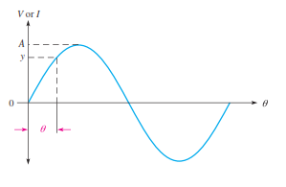
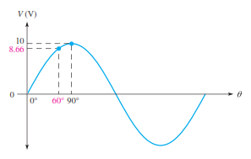
THE SINE WAVE FORMULA

Slide 4
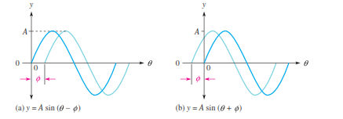
Expressions for Phase-Shifted Sine Waves

Slide 5
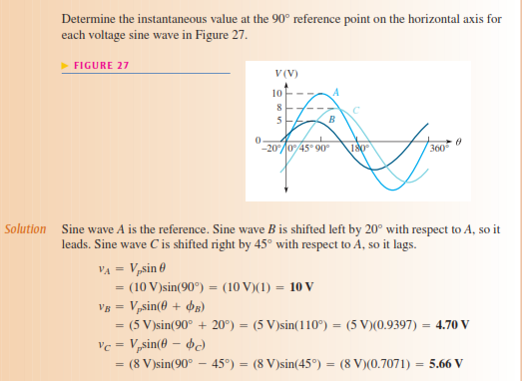
Example

Slide 6
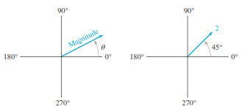
Phasor Diagram
In electronics, a phasor is a type of vector but the term generally refers to quantities that vary with time, such as sine waves.

Slide 7
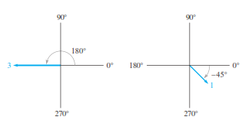
Examples

Slide 8
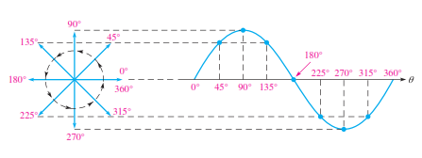
Phasor Representation of a Sine Wave
The instantaneous value of the sine wave at any point is equal to the vertical distance from the tip of the phasor to the horizontal axis.

Slide 9
Phasors and the Sine Wave Formula

Slide 10
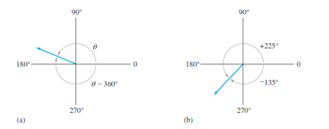
Positive and Negative Phasor Angles
Ө -360

Slide 11
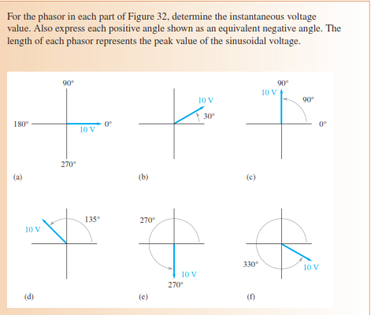
Example

Slide 12
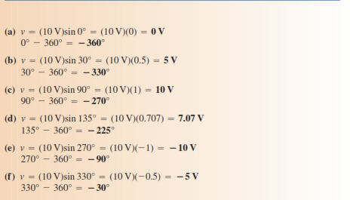
Solution

